Slide 1
Bayesian Computational Approaches
Brett Powers
April 28, 2020

Slide 2
Overview
Quick review of Mikes talk (Bayesian Thinking)
Why Bayesian?
Markov Chain Monte Carlo
Simple example

Slide 3

Bayes Theorem

Slide 4



Model Form
Is the set of parameters being estimated.
For example if we are trying to estimate the parameters of a Gaussian Distribution the parameter set would be:

Slide 5
Breaking it Down

Slide 6

Breaking it Down

Slide 7
Breaking it Down

Slide 8
Breaking it Down
What we want!

Slide 9
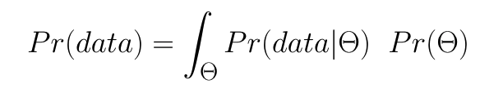
Breaking it Down
Normalizing factor
likelihood
prior

Slide 10
Markov Chain Monte Carlo (MCMC)
Can be a great way to calculate the posterior distribution without analytically solving for the integral.
Especially useful with non-standard likelihood and prior distributions.
With enough steps, it will converge to the correct posterior distribution we seek.

Slide 11
MCMC
Markov Chain: The next state ONLY depends on the current state.
Monte Carlo: The use of random sampling.

Slide 12
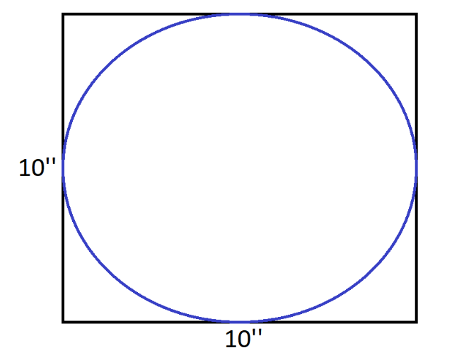
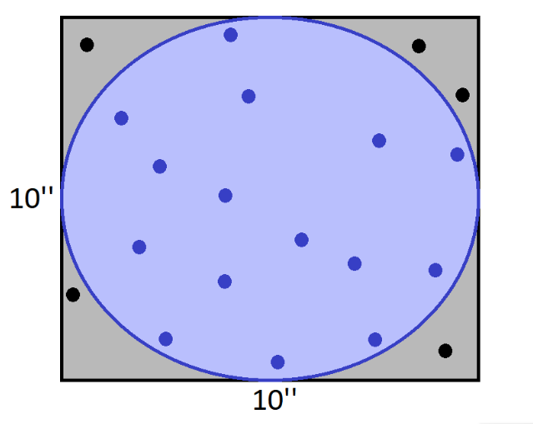


Monte Carlo
Y
Y
X
X

Slide 13
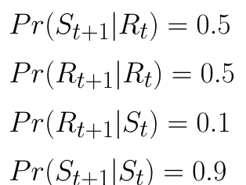
Markov Chain
S = sunny days
R = rainy days
S-S-R-R-S-S-S-S-S-R-R-R-S-S-S-…-…
After enough steps we will get
P(S)= 0.833
P(R)= 0.167
R-S-S-S-S-S-R-S-S-S-S-S-S-R-R-…-…

Slide 14





MCMC
Most common algorithm used is the Metropolis-Hastings (MH) algorithm. Estimates the distribution of metric (i.e. loss function)
Basic Idea:

Slide 15
PyMC3
Powerful MCMC sampling algorithms
Has an automatic assignment feature when implemented.
Hamiltonian Monte Carlo (NUTS)
Like MH but uses some ideas from physics.
Technically very heavy.
Great for high dimensional and complex posterior dist.

Slide 16
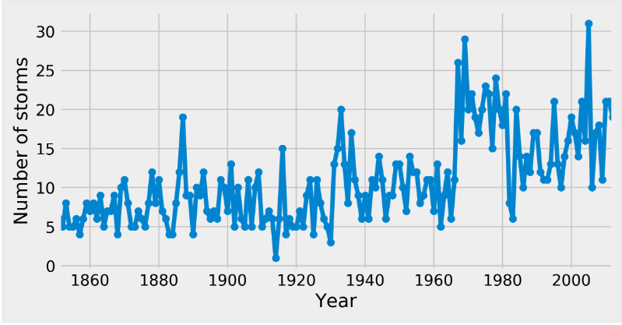
Example Using Storm Freq.
Assume a Poisson dist.
Early_mean
Switch Point
Late_mean

Slide 17
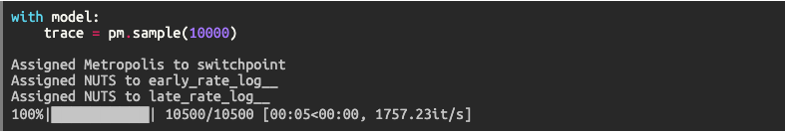
Example

Slide 18
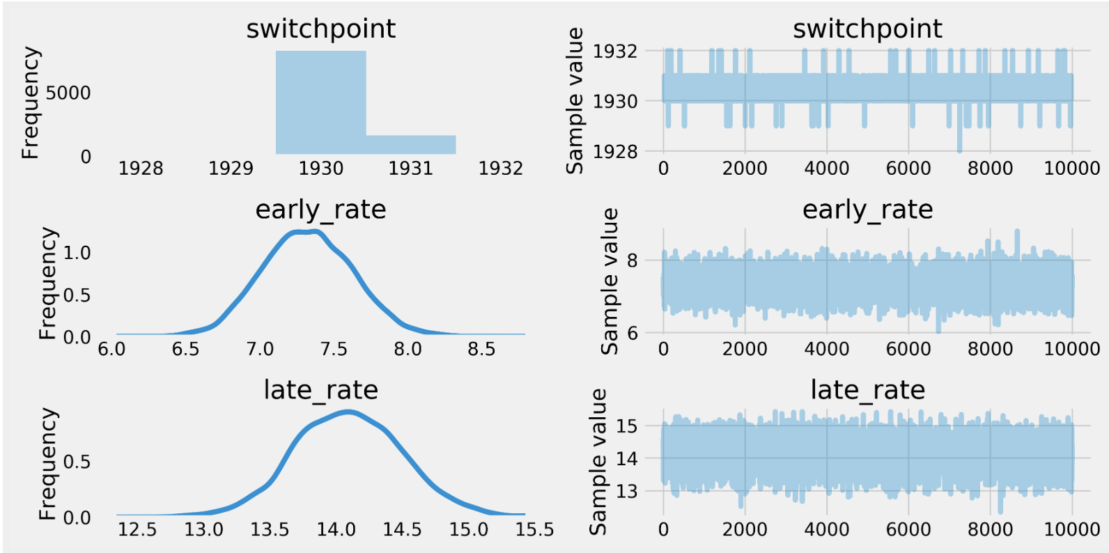
Example

Slide 19
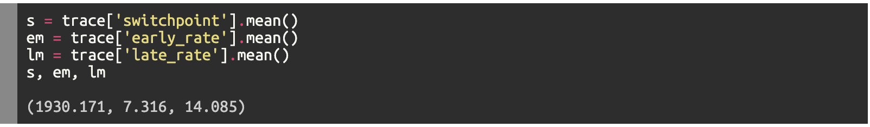
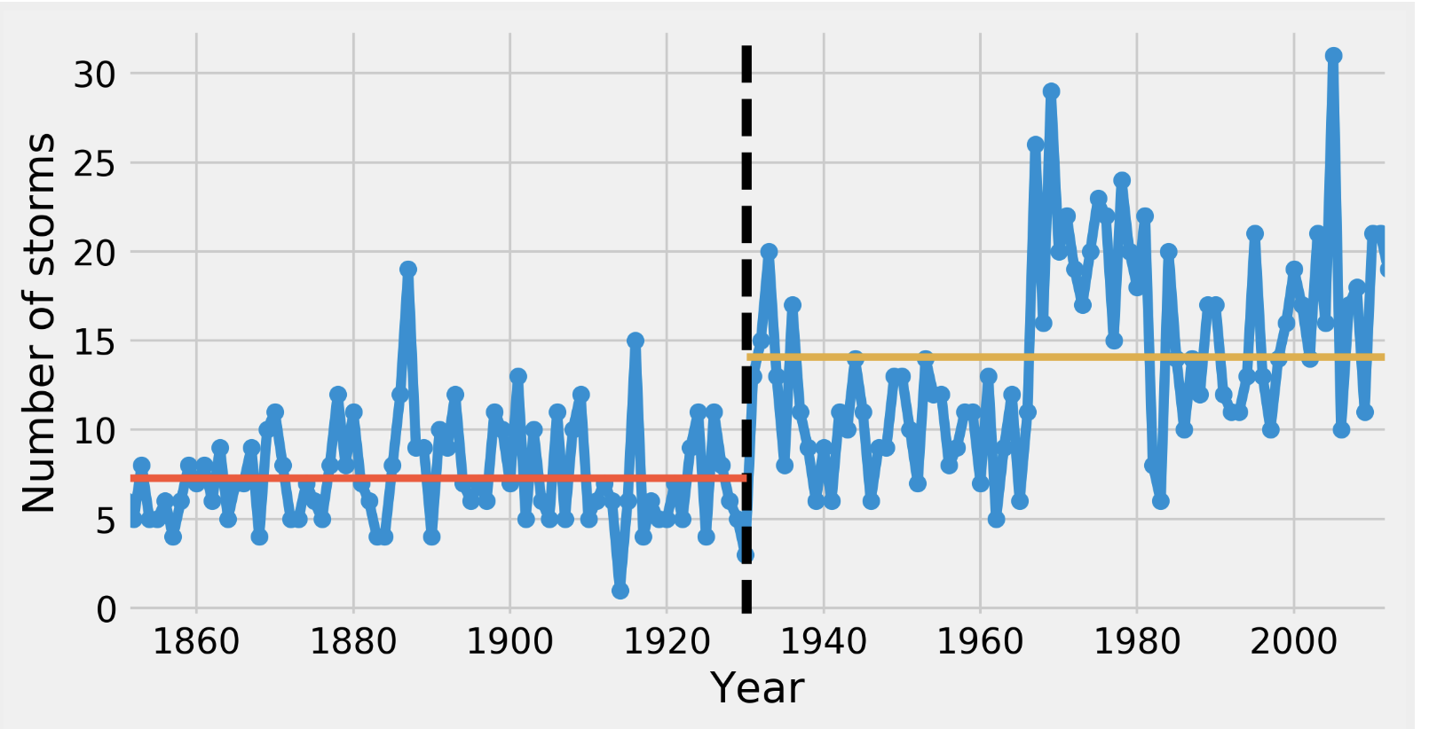
Example

Slide 20
Conclusion
When you have a high dimensional parameter space, PyMC3 can be used to find the “true” posterior dist. of the space.
Other packages like PySTAN, Hyperopt, Bayesian-optimization, and pyGPGO also do similar methods .

Slide 21
Sources
Example on github
https://github.com/ipython-books/cookbook-2nd-code/blob/master/chapter07_stats/07_pymc.ipynb
PyMC3 documentation - https://docs.pymc.io/

